Slide 1


CHAPTER FOUR
Dynamic HTML
HTML DOM
JavaScript

Slide 2

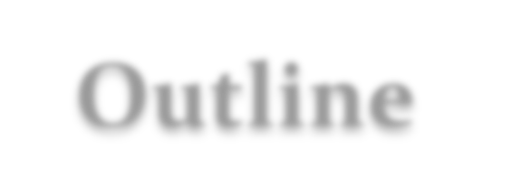


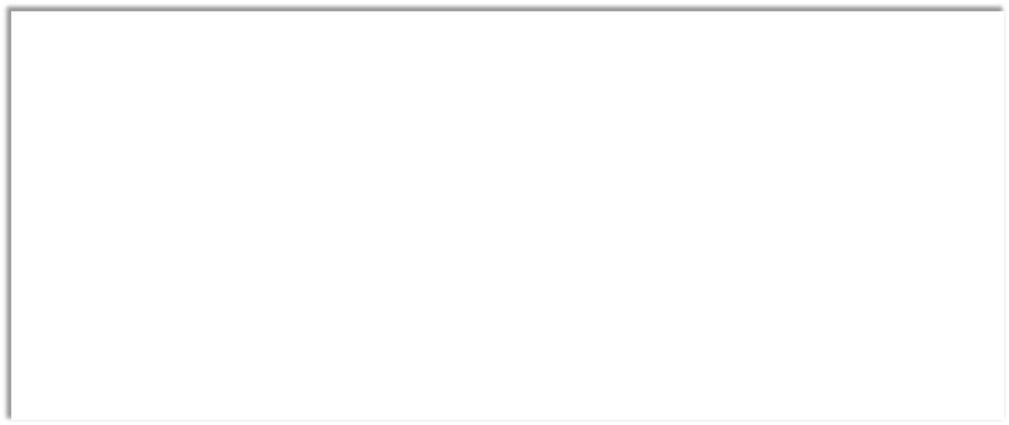
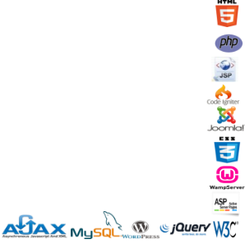



▪
DHTML
▪
The DOM
▪
Script Languages
▪
Introduction to Javascript
▪What is JS?
▪
What can a Javascript do?
▪
Embedding Javascript
▪Javascript programming Elements

Slide 3




‡
What is DHTML?
‡
DHTML stands for Dynamic HTML.
‡
DHTML is NOT a language or a web standard.
‡
DHTML means the combination of HTML, JavaScript, DOM and CSS.
‡
According to the World Wide Web Consortium (W3C): "Dynamic HTML is a term
used by some vendors to describe the combination of HTML, style sheets and
scripts that allows documents to be animated."

Slide 4


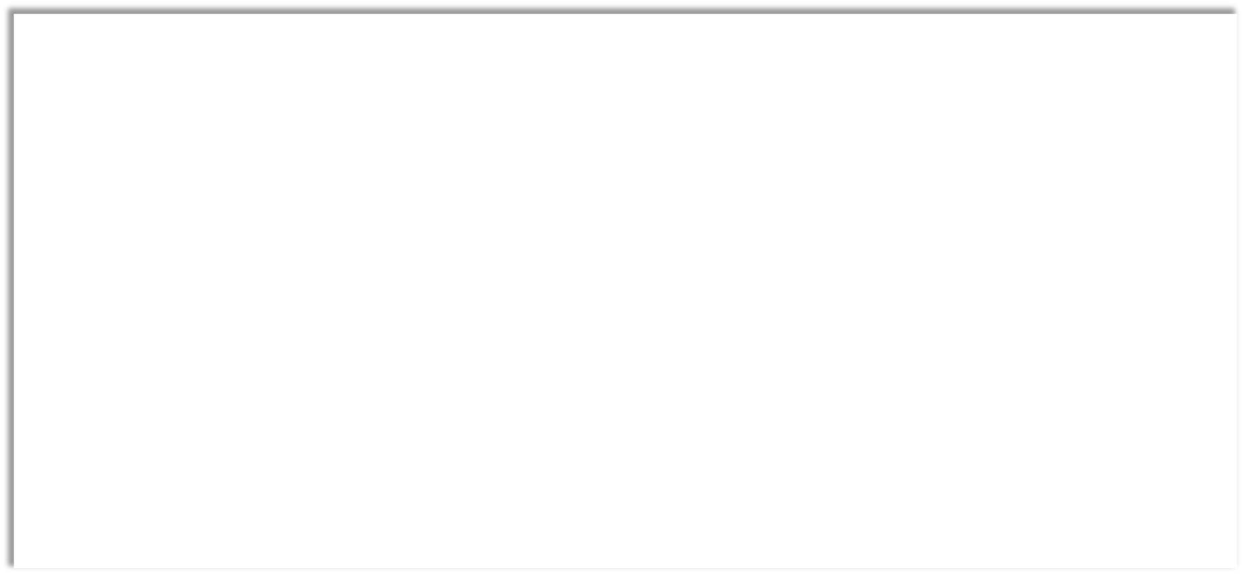

‡
The DOM (Document Object Model)
‡
is a platform and language-neutral interface that allows programs and scripts to
dynamically access and update the content, structure, and style of a document
‡
defines the objects and properties of all document elements, and the methods
(interface) to access them.
‡
The W3c DOM is separated into 3 different parts:
‡
Core DOM - standard model for any structured document
‡
XML DOM - standard model for XML documents
‡
HTML DOM - standard model for HTML documents

Slide 5


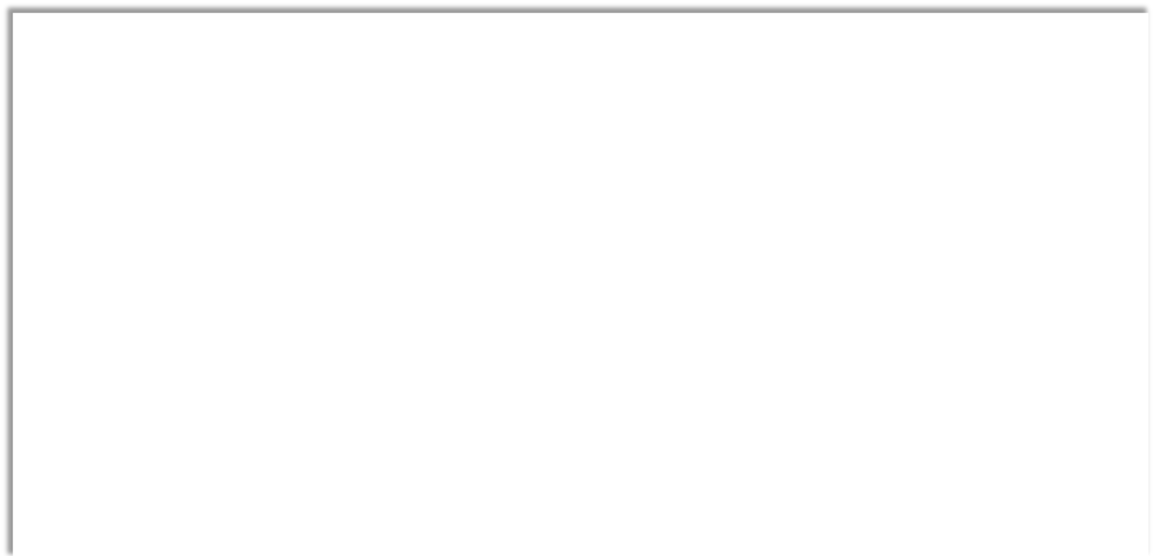

‡
The HTML DOM is a standard object model and programming interface for
HTML
‡
It defines:
‡
The HTML elements as objects
‡
The properties of all HTML elements
‡
The methods to access all HTML elements
‡
The events for all HTML elements
‡
In other words: The HTML DOM is a standard for how to get, change, add, or
delete HTML elements

Slide 6


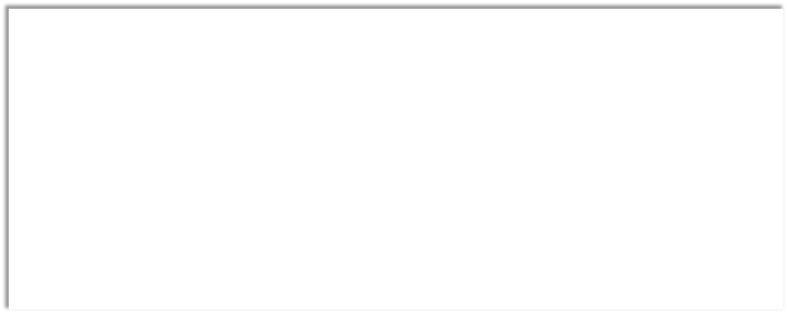

‡
According to the HTML DOM, everything in an HTML document is a node.
The HTML DOM says:
‡
The entire document is a document node
‡
Every HTML tag is an element node
‡
The text in the HTML elements are text nodes
‡
Every HTML attribute is an attribute node
‡
Comments are comment nodes

Slide 7
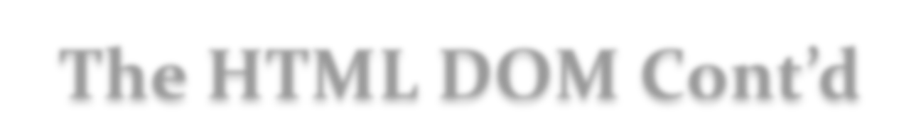




‡
The DOM views an HTML
document as a node-tree
‡
All nodes can be accessed
through the tree
‡
When a web page is
loaded, the browser
creates a Document
Object Model of the
page

Slide 8
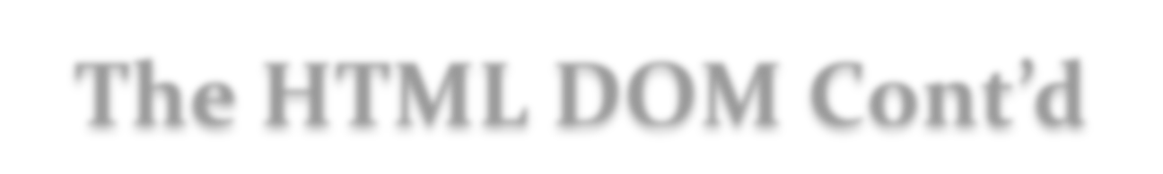



‡
The DOM models HTML as a set of node objects
‡
The programming interface to the DOM is defined by standard
properties and methods
‡
Property is a value that you can get or set (like changing the content of an HTML
element)
‡
Methods is an action you can do (like add or deleting an HTML element)

Slide 9





‡
HTML DOM Properties
‡
HTML DOM Methods
‡
x.innerHTML - the inner text value
‡
document.getElementById(id)
of x (an HTML element)
‡
get the element with a specified id
‡
x.nodeName - the name of x
‡
document.getElementsByTagName(name)
‡
x.nodeValue - the value of x
‡
get all elements with a specified tag
‡
x.parentNode - the parent node of x
name
‡
x.childNodes - the child nodes of x
‡
x.appendChild(node)
‡
x.attributes - the attributes nodes
‡
insert a child node to x
of x
‡
x.removeChild(node)
‡
remove a child node from x
Note: In the list above, x is a node object (HTML element).

Slide 10



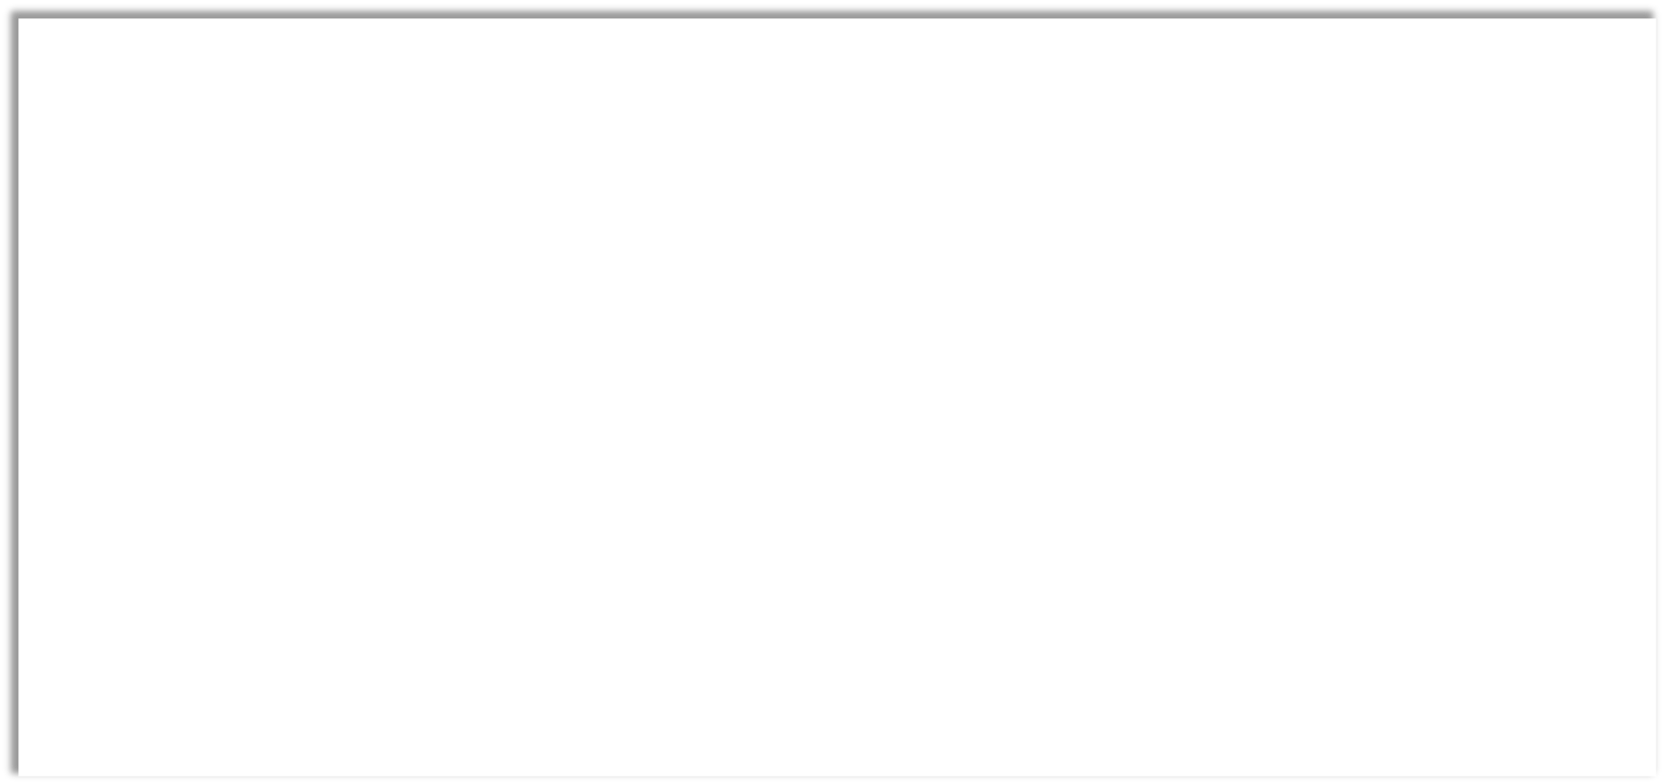
‡
With the DOM, you can access every node in an HTML document
‡
You can access a node in three ways:
‡
By using the getElementById() method
‡
returns the element with the specified ID
‡
document.getElementById("someID");
‡
By using the getElementsByTagName() method
‡
returns all elements with a specified tag name.
‡
x=document.getElementsByTagName("p");
‡
The <p> elements in x can be accessed by index number
‡
By navigating the node tree, using the node relationships
‡
The three properties parentNode, firstChild, and lastChild follow the document structure and
allow short-distance travel in the document.
‡
x=document.getElementById("intro");
‡
text=x.firstChild.innerHTML;

Slide 11



‡
innerHTML
‡ is useful for returning or replacing the content of HTML element
‡
can be used to get or change any HTML element, including <html> and <body>
‡
Example
‡
The JavaScript code to get the text from a <p> element with the id "intro" in HTML
document is:
‡
txt=document.getElementById("intro").innerHTML ;

Slide 12



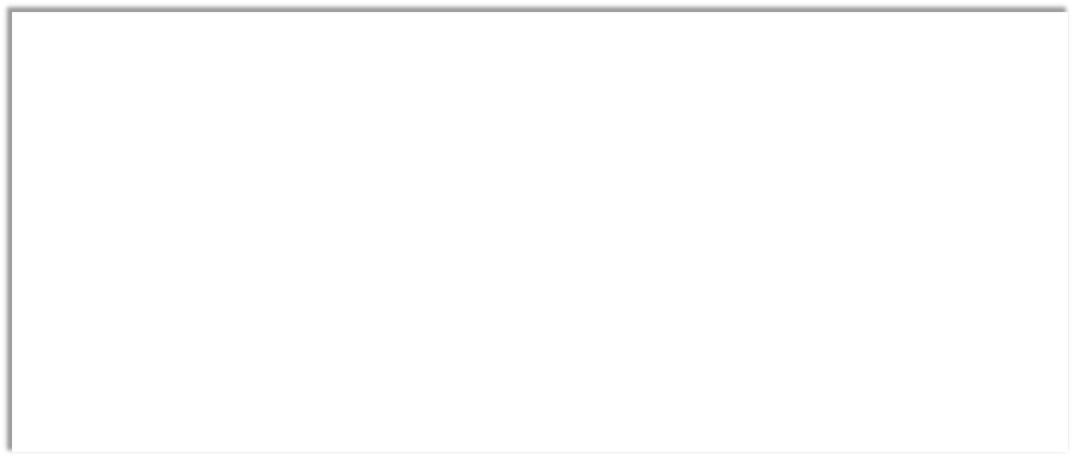
‡
Changing attribute of an HTML element
‡ Syntax
‡ document.getElementById(id).attribute=new value;
‡ Example
‡ document.getElementById("myImage").src = "landscape.jpg";
‡
Changing HTML Style
‡ Syntax
‡ document.getElementById(id).style.property=new style ;
‡ Example
‡ document.getElementById("p2").style.color = "blue";

Slide 13



‡
Window Object
‡
is the top level object in the JavaScript hierarchy. The Window object represents a browser window
‡
Document Object:
‡
represents the entire HTML document and can be used to access all elements in a page.
‡
The Document object is part of the Window object and is accessed through the window.document property.
‡
Navigator Object
‡
is actually a JavaScript object, not an HTML DOM object that contains information about the client browser
‡
Screen Object:
‡
is actually a JavaScript object, not an HTML DOM object that contains information about the client's display screen
‡
History Object:
‡
is actually a JavaScript object, not an HTML DOM object
‡
consists of an array of URLs. These URLs are the URLs the user has visited within a browser window
‡
is part of the Window object and is accessed through the window.history property.

Slide 14




Slide 15



‡
Script Languages
‡
are subset of programming languages
‡
are not compiled to machine code by the user. Rather, another program
called the interpreter, runs the program and simulates its behavior
‡
are intended to be very fast to learn and write in programs
‡
There are two groups of script languages on the web:
‡
Client Side and Server Side Script languages

Slide 16



‡
Client Side Script
‡
refers to the class of computer programs on the web that are executed client-side, by the
user's web browser, instead of server-side (on the web server)
‡
is an important part of the Dynamic HTML (DHTML) concept, enabling web pages to be
scripted; that is, to have different and changing content depending on user input,
environmental conditions (such as the time of day), or other variables
‡
are not allowed to access the user's computer beyond the web browser application
‡
put less stress on the server because they don’t require processing on the server once
they’re downloaded
‡
Examples: JavaScript, VB script

Slide 17
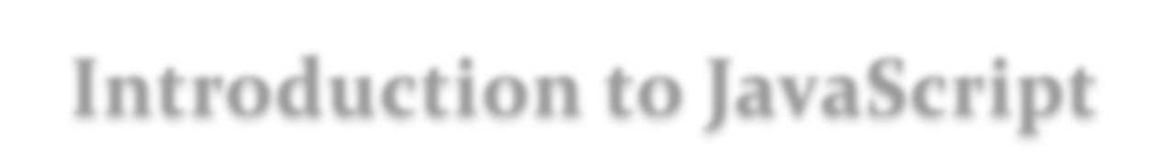


‡
JavaScript
‡ is a client side scripting language
‡ is an interpreted language (means that scripts execute
without preliminary compilation)
‡ was designed to add interactivity to HTML pages
‡ is usually embedded directly into HTML pages

Slide 18
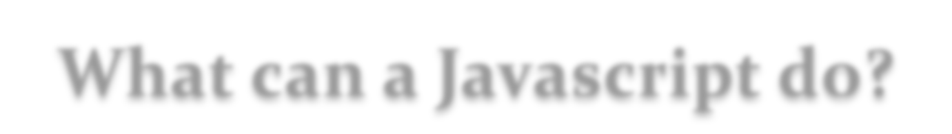


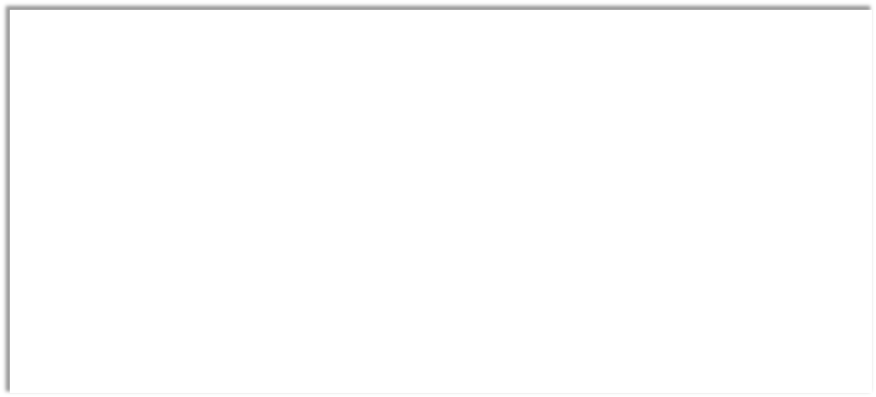
‡
With the help of the DOM, JavaScript gets all the power it needs to create
dynamic HTML:
‡
JavaScript can put dynamic text into an HTML page
‡
JavaScript can change attributes of HTML elements
‡
JavaScript can change CSS styles of HTML elements
‡
JavaScript can remove existing HTML elements and attributes
‡
JavaScript can add new HTML elements and attributes
‡
JavaScript can react to all existing HTML events in the page
‡
JavaScript can be used to validate form data
‡
JavaScript can be used to detect the visitor's browser
‡
JavaScript can be used to create cookies
‡
etc...

Slide 19
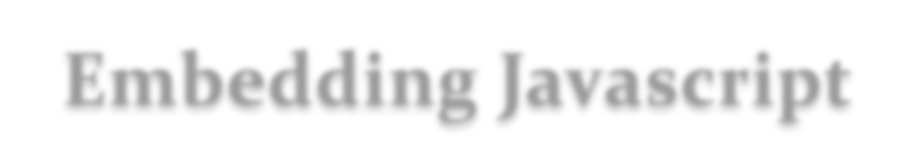


‡
You can place any number of scripts in an HTML
document
‡ JavaScript can be placed
‡ in the <head> tag
‡ in the <body> tag
‡ in external files

Slide 20
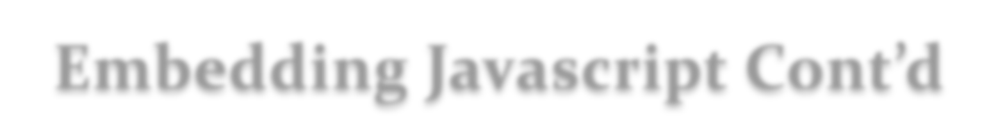


‡ JavaScript in <head> and/or <body>
‡
In HTML, JavaScript code must be inserted between <script> and </script>
tags
‡
Scripts that are defined outside of a function will be executed while the page is
loading.
‡
Scripts that are defined in a function are executed when "asked" for.
‡
Placing scripts at the bottom of the <body> element improves page load,
because HTML display is not blocked by scripts loading
<script>
</script>

Slide 21

‡
External JavaScript File
‡
are practical when the same code is used in many different web pages
‡
have .js file extentions
‡
External scripts cannot contain <script> tags.
‡
You can place an external script reference in <head> or <body> as you like
‡
Placing JavaScripts in external files has some advantages:
‡
It separates HTML and code
‡
It makes HTML and JavaScript easier to read and maintain
‡
Cached JavaScript files can speed up page loads
‡
d
<body>
</body>

Slide 22

‡
Not all browsers support JavaScript.
‡
E.g. NN1, IE2, character-based lynx.
<script language=‚JavaScript‛>
<!-- begin hiding JavaScript
document.write(‘Hello World’);
End hiding JavaScript -->
</script>
<noscript>
Your browser does not support JavaScript.
</noscript>

Slide 23
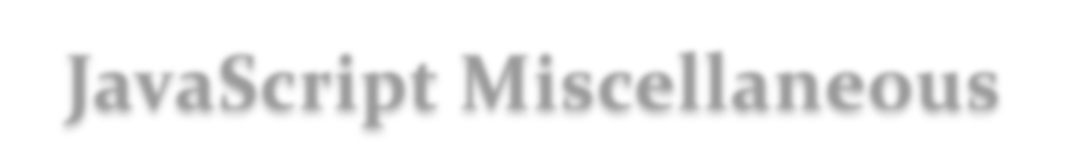


‡
JavaScript statements are separated by semicolons.
‡
JavaScript is a case-sensitive language
‡
JavaScript comments
‡
// Single Line Comment
‡
/* Multi line comment*/
‡
JavaScript ignores spaces, tabs, and newlines that appear in JavaScript
programs.

Slide 24
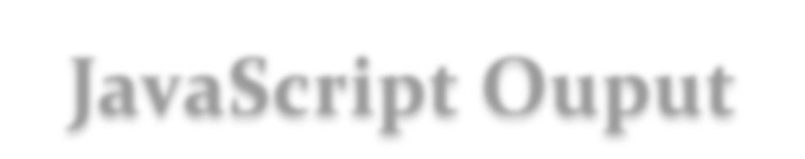


‡
JavaScript does NOT have any built-in print or display functions.
‡ JavaScript Display Possibilities
‡
JavaScript can "display" data in different ways:
‡ Writing into an alert box, using window.alert()
‡ Writing into the HTML output using document.write()
‡ Writing into an HTML element, using innerHTML
‡ Writing into the browser console, using console.log()

Slide 25
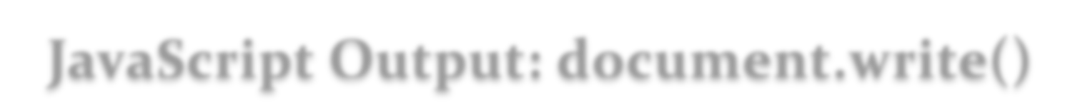
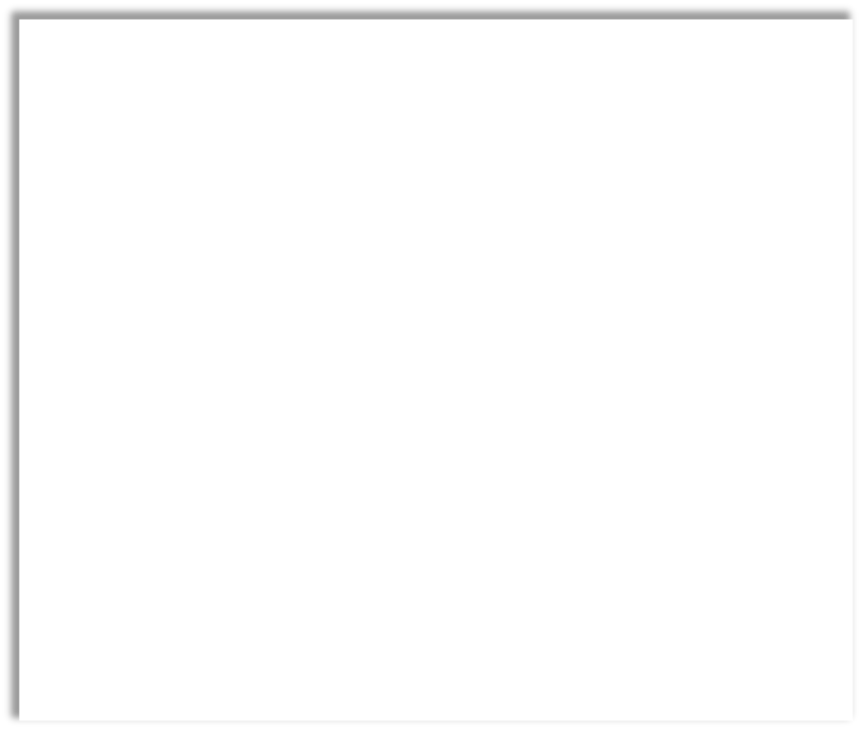

•
For testing purposes, it is
<body>
convenient to use
<h1>My First Web Page</h1>
<p>My first paragraph.</p>
document.write():
<script>
•
Using document.write() after
</script>
an HTML document is fully
</body>
loaded, will delete all
existing HTML

Slide 26
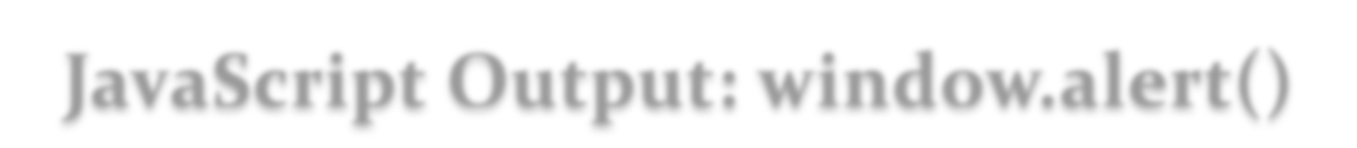


• You can use an
<body>
<h1>My First Web Page</h1>
<p>My first paragraph.</p>
alert box to
<script>
display data:
</script>
</body>

Slide 27
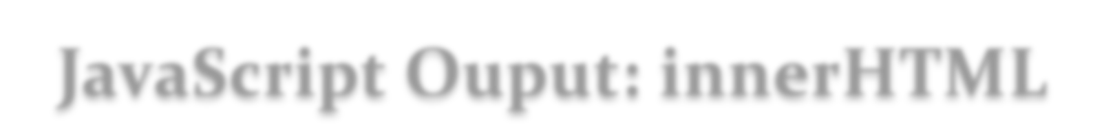

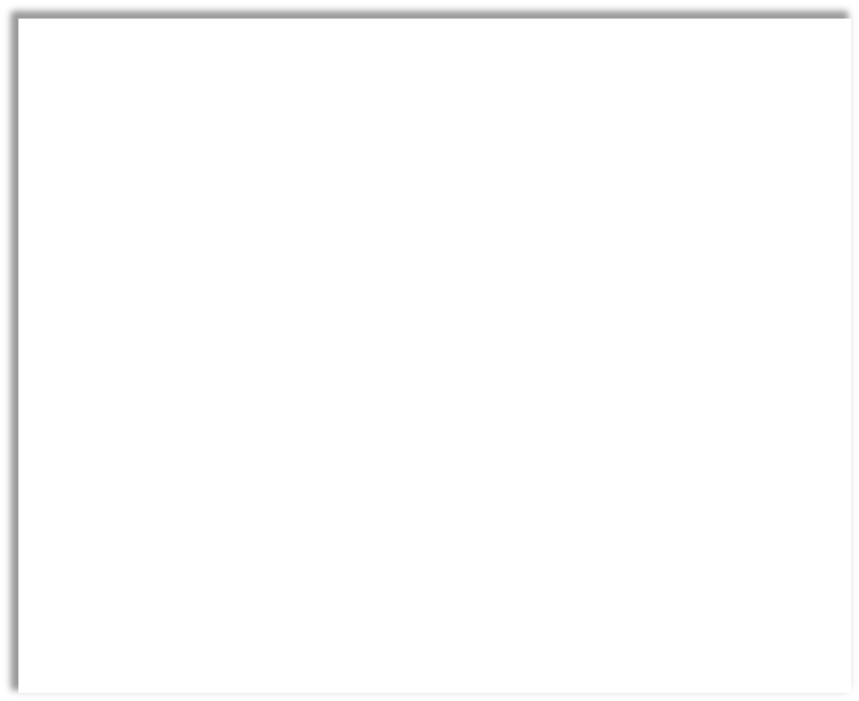

▪The innerHTML
<body>
<p>My First Paragraph</p>
property defines an
<p id="demo"></p>
HTML element
<script>
document.getElementById("demo").
innerHTML = ‚Hello there‛;
content
</script>
</body>

Slide 28
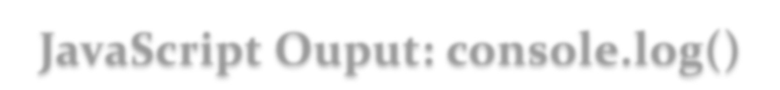


▪
In your browser, you can
<body>
use the console.log()
<h1>My First Web Page</h1>
<p>My first paragraph.</p>
method to display data
<script>
▪
Activate the browser
</script>
console with F12, and
</body>
select "Console" in the
menu.

Slide 29
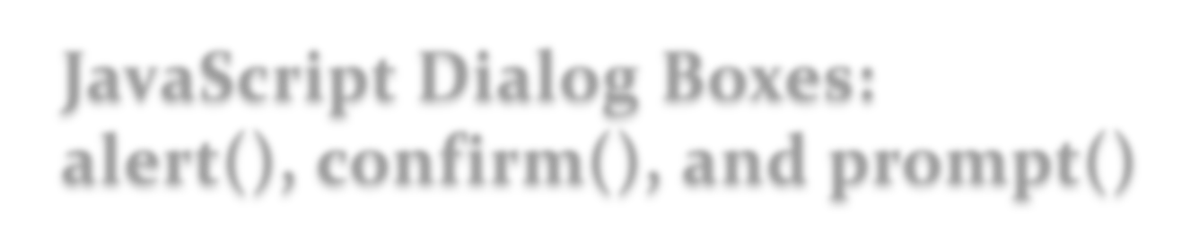
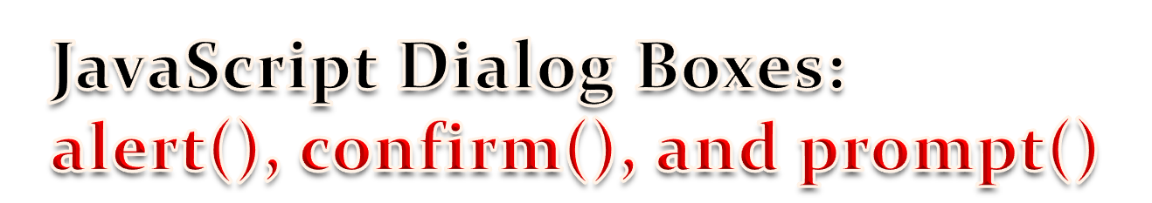
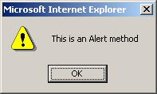
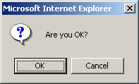
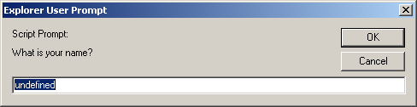
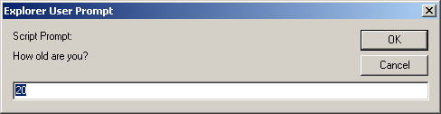
<script type="text/javascript">
alert("This is an Alert method");
confirm("Are you OK?");
prompt("What is your name?");
prompt("How old are you?","20");
</script>

Slide 30



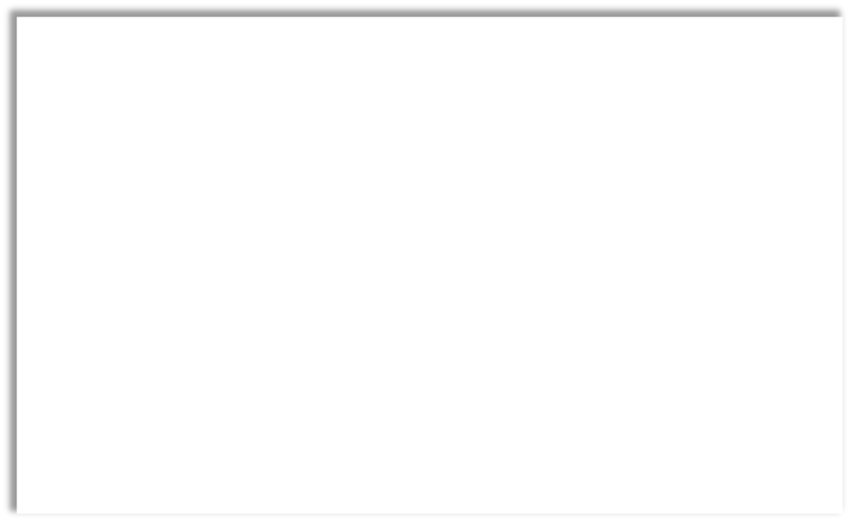


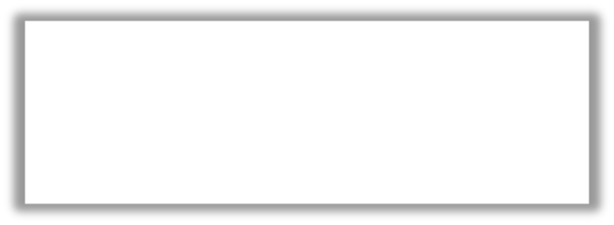
▪
JavaScript Variables
▪Javascript Literals
▪Numbers are written with or without
▪
the var keyword is used to define
decimals:
variables
▪10.01 or 10
▪
can hold a value of any data type
▪Strings are text, written within double or
single quotes:
▪
A variable may or may not be
▪"John Doe“ or 'John Doe'
declared before usage
▪NaN - is a JavaScript reserved word
▪
must begin with a letter or an
indicating that a value is not a number
underscore character
var x = 6;
▪
variable names should not start
var y = 6.5;
var name = ‚Abebe‛
with a numeral (0-9)
var alpha = ‘B’;

Slide 31



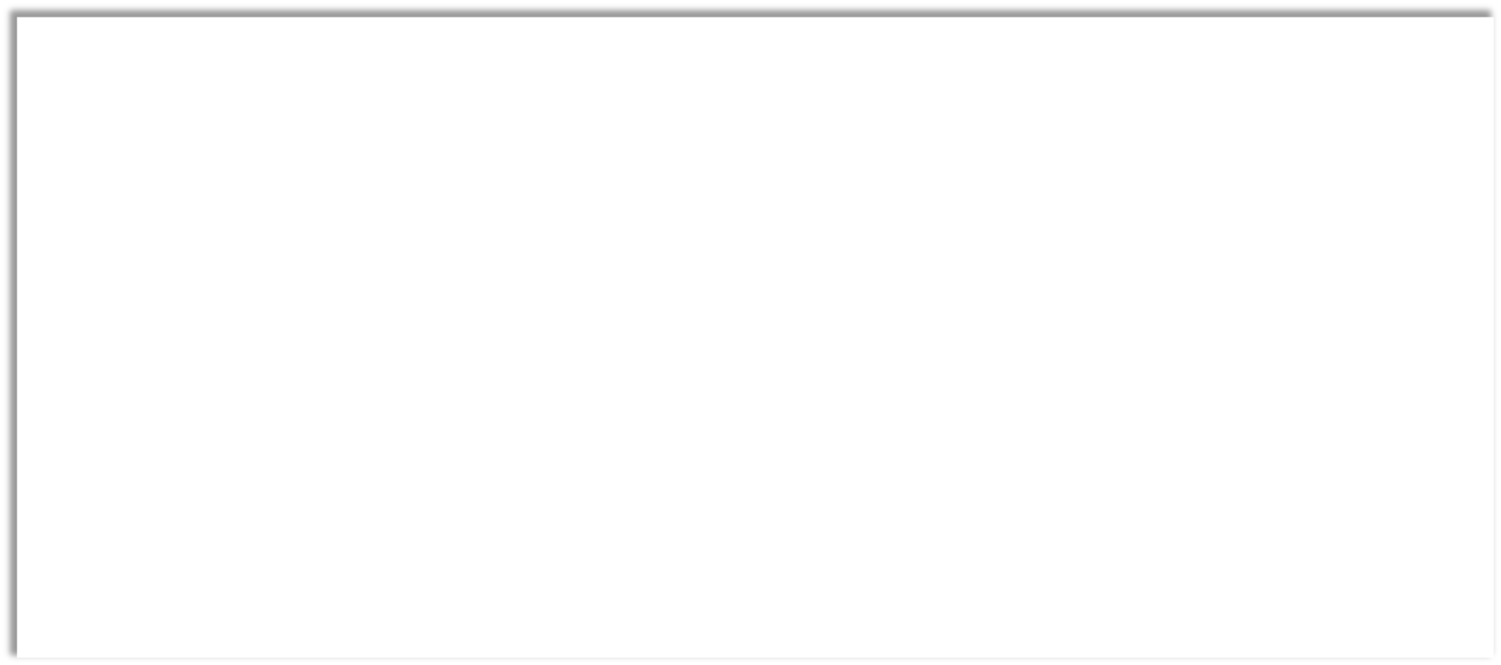
▪
JavaScript allows the same variable to contain different types of data values.
▪
Primitive data types
▪
Number: integer & f loating-point numbers
▪
Boolean: logical values “true” or “false”
▪
String: a sequence of alphanumeric characters
▪
Composite data types (or Complex data types)
▪
Object: a named collection of data
▪
Array: a sequence of values
▪
Special data types
▪
Null: an initial value is assigned
▪
Undefined: the variable has been created by not yet assigned a value

Slide 32
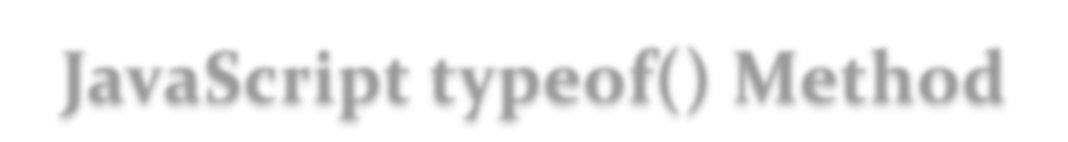




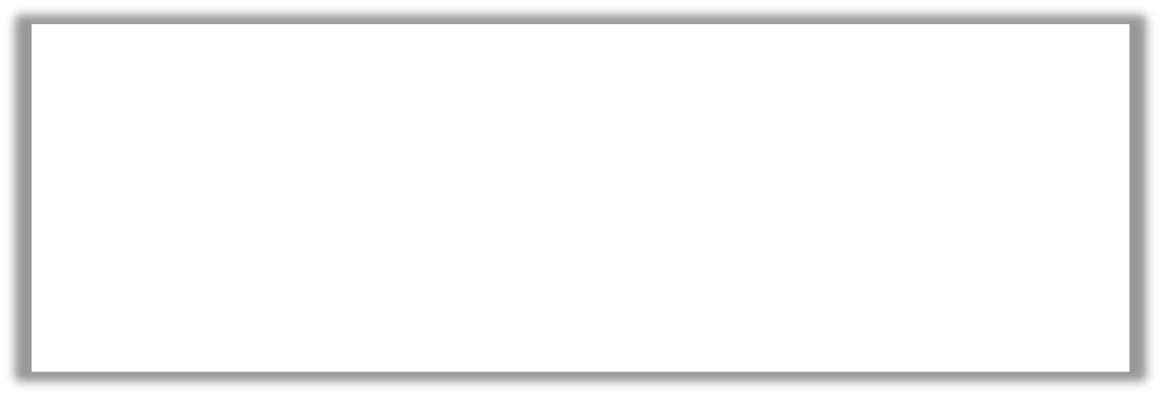
▪
The typeof Operator
var length = 16;
// Number
var lastName = "Johnson";
// String
▪Used to find out
var cars = ["Saab", "Volvo", "BMW"];
// Array
var x = {firstName:"John", lastName:"Doe"}; // Object
the type of a
typeof "John"
// Returns string
JavaScript variable
typeof 3.14
// Returns number
typeof false
// Returns boolean
typeof [1,2,3,4]
// Returns object
typeof {name:'John', age:34} // Returns object

Slide 33


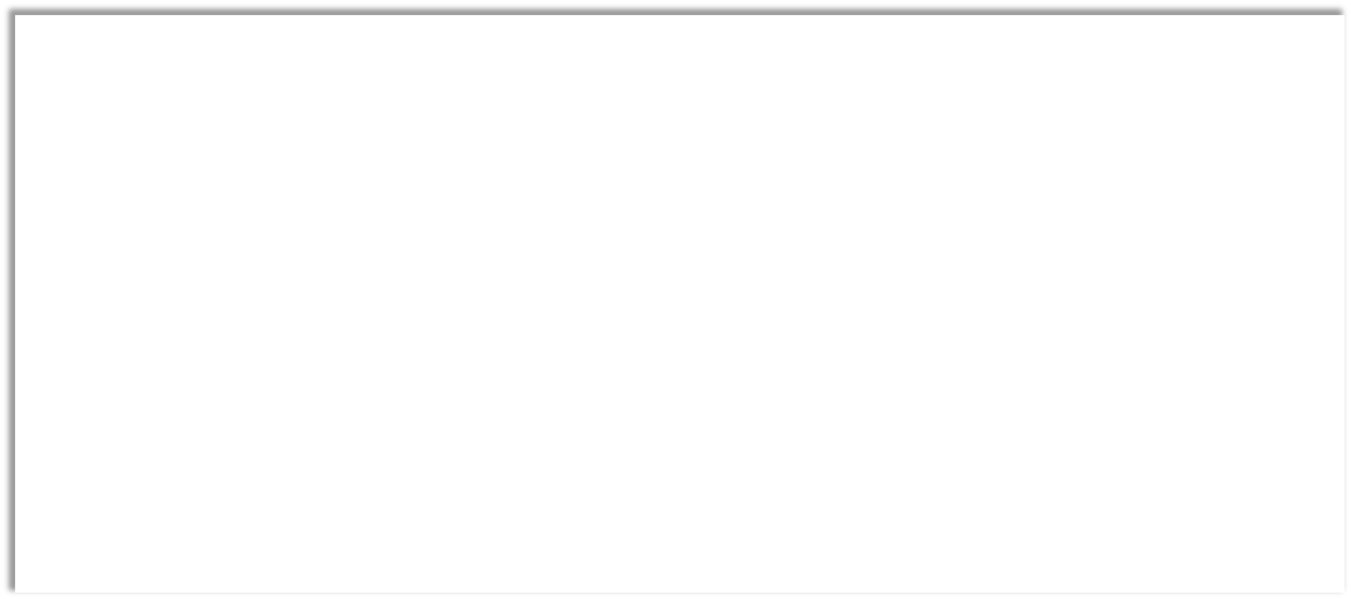

▪
Artihmetic Operators
▪
+, -, *, /, %, ++, --
▪
Operator
Description
Comparing
Returns
Assignment Operators
▪
+=, -=, *=, /=, %=
5 == 5
true
▪
Comparison Operators
==
equal to
5 == "5"
true
▪
>, <, >=, <=, ==, ===, !=, !==
▪
Bitwise Operators
equal value
and equal type
5=== 5
true
===
▪
&, |, ~, <<, >>
5 === "5"
false
▪
String Operators
▪
txt1 = "John";
txt2 = "Doe";
txt3 = txt1 + " " + txt2;
▪
txt1 = "What a very ";
txt1 += "nice day";

Slide 34
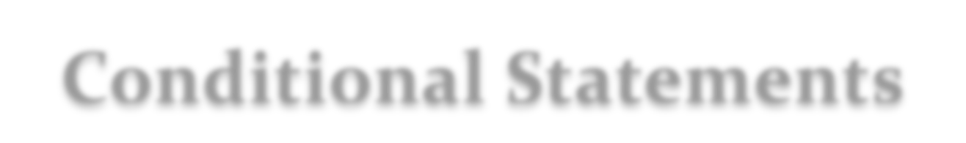


▪
JavaScript have the following conditional statements:
▪
Use if to specify a block of code to be executed, if a specified condition is
true
▪
Use else to specify a block of code to be executed, if the same condition is
false
▪
Use else if to specify a new condition to test, if the first condition is false
▪
Use switch to specify many alternative blocks of code to be executed

Slide 35
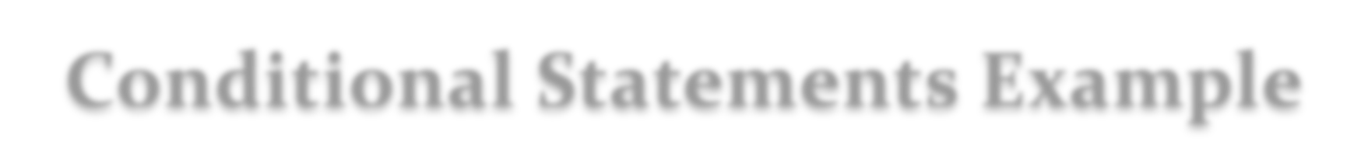
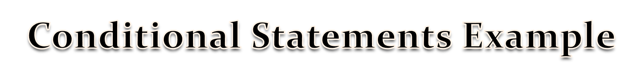
<body>
<body>
<p>Click the button to get a time-based greeting:</p>
<script>
<button onclick="myFunction()">Try it</button>
<p id="demo"></p>
switch (new Date().getDay()) {
case 1:
<script>
function myFunction() {
case 2:
var greeting;
case 3:
default:
var time = new Date().getHours();
if (time < 10) {
break;
greeting = "Good morning";
case 4:
case 5:
} else if (time < 20) {
greeting = "Good day";
break;
case 0:
} else {
greeting = "Good evening"; }
document.getElementById("demo").innerHTML = greeting;
text = "It is Weekend";
}
}
</script>
</script>
</body>
</body>

Slide 36



▪
JavaScript supports different kinds of loops:
▪for
▪
loops through a block of code a number of times
▪for/in
▪
loops through the properties of an object
▪while
▪
loops through a block of code while a specified condition is true
▪do/while
▪
also loops through a block of code while a specified condition is true

Slide 37



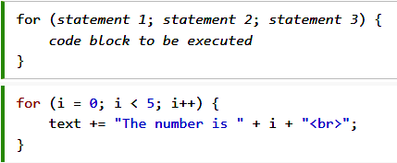


▪
The for loop has the following syntax:
<p id="demo"></p>
<script>
var cars = ["BMW", "Volvo", "Saab", "Ford"];
var i, len, text;
for (i = 0, len = cars.length, text = ""; i < len; i++) {
text += cars[i] + "<br>";
}
document.getElementById("demo").innerHTML = text;
</script>

Slide 38



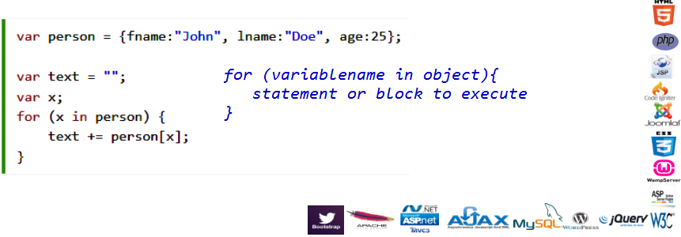
▪for/in statement loops through the
properties of an object

Slide 39



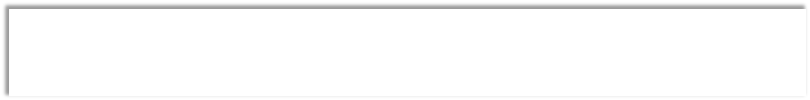
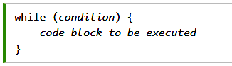
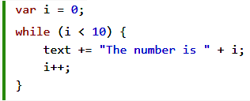
▪
The while loop loops through a block of code as long as
a specified condition is true.

Slide 40


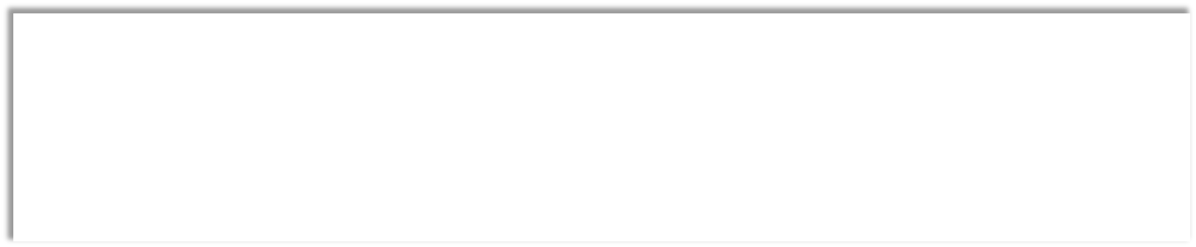

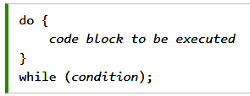
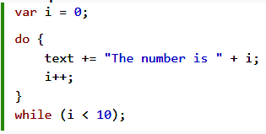
▪
This loop executes the code block at least once, before checking if the
condition is true, then it will repeat the loop as long as the condition is
true.

Slide 41


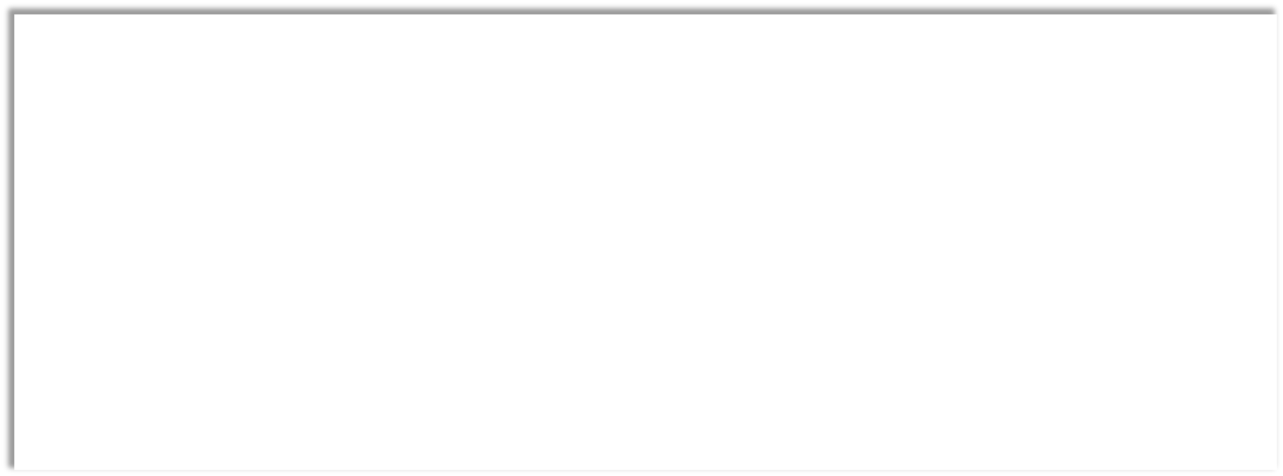

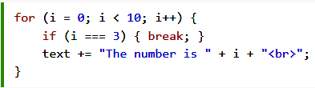
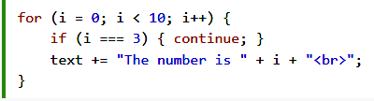
▪
Break
▪
used to jump out of a loop or a switch block
▪
breaks the loop and continues executing the code after the loop (if any):
▪
Continue
▪
breaks one iteration (in the loop), if a specified condition occurs, and continues with the next
iteration in the loop

Slide 42
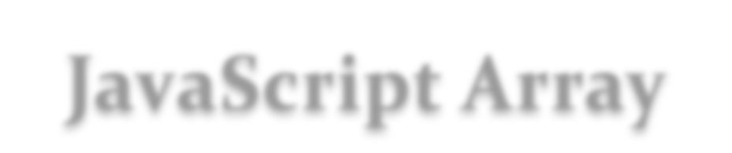



▪
Creating an Array
▪Syntax:
▪var array-name = [item1, item2, ...];
▪Using the new keyword
▪Example:
▪var cars = ["Saab", "Volvo", "BMW"];
▪var cars = new Array("Saab", "Volvo", "BMW");
▪
Array can hold different objects/datatypes
▪
Array index starts with 0

Slide 43



▪Arrays use numbers to access its "elements”
▪var person = ["John", "Doe", 46];
▪person[0] returns John
▪Objects use names to access its "members".
▪var person = { firstName:"John", lastName:"Doe", age:46};
▪person.firstname returns John

Slide 44




▪
The length Property
▪
returns the length of an array
▪
Example
▪var fruits = ["Banana", "Orange", "Apple", "Mango"];
fruits.length;
▪
Adding Array Elements
▪
The easiest way to add a new element to an array is using the push
method:
▪
Example
▪var fruits = ["Banana", "Orange", "Apple", "Mango"];
fruits.push("Lemon");
▪
Sorting Array Elements
▪var y = fruits.sort();
// sort cars in alphabetical order

Slide 45




▪
Function Syntax
var x = myFunction(4, 3);
▪
Function parameters are the names listed in the function definition
function name(para1, para2) {
code to be executed
▪
function myFunction(a, b) {
return a * b;
Function arguments are the real values received by the function when it is invoked.the function, the
}
arguments behave as local variables.
}
▪
Function Invocation
▪
The code inside the function will execute when "something" invokes (calls) the function:
▪
When an event occurs (when a user clicks a button)
▪
When it is invoked (called) from JavaScript code
▪
Automatically (self invoked)
▪
Function Return
▪
When JavaScript reaches a return statement, the function will stop executing.
▪
If the function was invoked from a statement, JavaScript will "return" to execute the code after the invoking
statement.

Slide 46




▪
HTML Events
▪
An HTML event can be something the browser does, or something a user does
▪
Some examples of HTML events:
▪
An HTML web page has finished loading
▪
An HTML input field was changed
▪
An HTML button was clicked
▪
JavaScript lets you execute code when events are detected.
▪
HTML allows event handler attributes, with JavaScript code, to be added to HTML
elements
▪
Syntax: <some-HTML-element some-event="some JavaScript">
▪
Ex: <button onclick=‘displayDate();‘>The time is?</button>

Slide 47






▪
The onload event
▪
The onunload event
▪
occurs when an object has been loaded
▪
occurs once a page has
▪
is most often used with the <body>
element to execute a script once a web
unloaded
page has completely loaded all content
▪
occurs when the user navigates
▪
can be used to check the visitor's browser
away from the page (by
type and browser version, and load the
proper version of the web page based on
clicking on a link, submitting a
the information
form, closing the browser
▪
can also be used to deal with cookies
window, etc.).

Slide 48






▪
onsubmit event
▪
occurs when you try to submit a form
▪
often used to trigger a form validator function
▪
In the following example: if validate() function returns true, the form will be submitted,
otherwise it will not submit the data
<script>
function validation() {
all validation goes here .........
return either true or false
}
</script>
<body>
<form method="POST" action=‚reg.asp" onsubmit="return validate();">
.......
<input type="submit" value="Submit" />
</form>
</body>

Slide 49





▪
The onmouseover event
▪
triggers when you bring your mouse over any element and
▪
The onmouseout event
▪
triggers when you move your mouse out from an element
<script>
function over() {
document.getElementById("h2").innerHTML="Mouse Over";}
function out() {
document.getElementById("h2").innerHTML="Mouse Out";}
</script>
<body>
<div onmouseout="out();" onmouseover="over();" >
<h2 id="h2"> This is inside the division </h2>
</div>
</body>

Slide 50



▪
The onFocus, onBlur and onChange events are often
used in combination with validation of form fields
▪Example:
▪
<input type="text“ id="email" onchange="checkEmail()">

Slide 51


Event
Description
Event
Description
occurs when a finger is placed
on a touch screen
occurs when the user double-clicks
on an element
ontouchstart
ondblclick
occurs when an element gets user
input
onclick
The user clicks an HTML element
oninput
occurs when the media has
been started
onplay
onsubmit
occurs when a form is submitted
occurs when the browser starts
to work offline
occurs when an element is being
dragged
onoffline
ondrag
occurs when the user copies the
content of an element
onkeydown
The user pushes a keyboard key
Oncopy
The browser has finished loading
the page
occurs when a page is about to be
printed
onload
onbeforeprint

Slide 52






▪
JavaScript objects are containers for
named values
▪
var person = {
Accessing Object properties
firstName: "John",
▪
objectName.propertyName or
lastName : "Doe",
objectName["propertyName"]
id : 5566,
▪
Example
fullName : function() {
▪
return this.firstName + " " +
person.firstName or person[“firstName”]
this.lastName;
▪
Accessing Object Methods
}
▪
objectName.methodName()
};
▪
Example
▪
person.fullName();

Slide 53







▪
A string can be any text inside quotes. You can use single or double quotes:
▪
var carname = 'Volvo XC60';
▪
You can use quotes inside a string, as long as they don't match the quotes
surrounding the string:
▪
var answer = "It's alright";
▪
The other solution is to use escape characters
▪
var answer = ‘It\’s alright’;
▪
Other escape characters: \’ , \” , \\ , \n, \t ….
▪
The length of a string is found in the built in property length
▪
answer.length

Slide 54


Event
Description
charAt()
Returns the character at the specified index (position)
concat()
Joins two or more strings, and returns a copy of the joined strings
Searches a string for a match against a regular expression, and
match()
returns the matches
toLowerCase()
Converts a string to lowercase letters
trim()
Removes whitespace from both ends of a string
split()
Splits a string into an array of substrings

Slide 55






<p id="demo"></p>
<script>
var d = new Date();
document.getElementById("demo").innerHTML = d;
</script>
▪
A date consists of a year, a month, a day, an hour, a minute, a second,
and milliseconds.
▪
Date objects are created with the new Date() constructor
▪
Using new Date(), creates a new date object with the current date and
time
▪
When you display a date object in HTML, it is automatically
converted to a string, with the toString() method.

Slide 56



Get Methods
Description
getDate()
Get the day as a number (1-31)
<p id="demo"></p>
Get the weekday as a number
<script>
getDay()
(0-6)
var d = new Date();
getFullYear()
Get the four digit year (yyyy)
var p=document.getElementById("demo");
getHours()
Get the hour (0-23)
p.innerHTML = d.getDate() + " " +
d.getDay() + " " +
getMilliseconds()
Get the milliseconds (0-999)
d.getMonth() + " " +
getMinutes()
Get the minutes (0-59)
d.getFullYear();
</script>
getMonth()
Get the month (0-11)
getSeconds()
Get the seconds (0-59)

Slide 57






▪
The Math Object
▪
allows to perform mathematical tasks
▪
includes several mathematical methods
▪
Math.min() and Math.max()
▪
can be used to find the lowest or highest value in a list of arguments
▪
Example: Math.min(0, 150, 30, 20, -8, -200);
// returns -200
▪
Math.random()
▪
returns a random number between 0 (inclusive), and 1 (exclusive):
▪
Math.round()
▪
rounds a number to the nearest integer
▪
Example: Math.round(4.7);
// returns 5

Slide 58



▪
A Regular Expression
▪
is a sequence of characters that forms a search pattern
▪
When you search for data in a text, you can use this search pattern to
describe what you are searching for.
▪
The JavaScript RegExp class represents regular expressions
▪Syntax
▪var pattern = /pattern/attributes;
▪var pattern = new RegExp(pattern, attributes);
▪pattern:
▪
A string that specifies the pattern of the regular expression or another
regular expression.
▪attributes:
▪
An optional string containing any of the "g", "i", and "m" attributes that
specify global, case-insensitive, and multiline matches, respectively.

Slide 59


Expression
Description
[abc]
Find any of the characters between the brackets
[0-9]
Find any of the digits between the brackets
(x|y)
Find any of the alternatives separated with |
Quantifier
Description
n+
Matches any string that contains at least one n
n*
Matches any string that contains zero or more occurrences of n
n?
Matches any string that contains zero or one occurrences of n
MetaCharacter
Description
\d
Find a digit
\s
Find a whitespace character
\b
Find a match at the beginning or at the end of a word

Slide 60


Slide 61



▪
In JavaScript, the RegExp object is a regular expression object with predefined properties and
methods.
▪
Using the RegExp method test()
▪
It searches a string for a pattern, and returns true or false, depending on the result.
▪
The following example searches a string for the character "e":
var patt = /e/;
patt.test("The best things in life are free!");
▪
Using the RegExp method exec()
▪
It searches a string for a specified pattern, and returns the found text.
▪
If no match is found, it returns null.
▪
The following example searches a string for the character "e":
/e/.exec("The best things in life are free!"); \\returns e

Slide 62






▪
Using String search() With a Regular Expression
▪
Use a regular expression to do a case-insensitive search for "w3schools" in a string:
▪var str = "Visit W3Schools";
var n = str.search(/w3schools/i); //returns 6
▪
Use String match() With a Regular Expression
▪
searches a string for a match against a regular expression, and returns the matches, as an Array
object or returns null if no match is found.
▪
Syntax: string.match(regexp)
▪var str = ‚The rain in SPAIN stays mainly in the plain ";
var res = str.match(/ain/gi);
▪
The result in res will be:
▪ain,AIN,ain,ain

Slide 63



▪
A web page can be refreshed using JavaScript location.reload method
▪
The method can be called automatically upon an event or simply when
the user clicks on a link
▪
<a href="location.reload(true);">Refresh Page</a>
▪
Auto Refresh
▪
setTimeout() is a built-in JavaScript function which can be used to execute
another function after a given time interval
▪
<body onload='setTimeout("location.reload(true);",2000);’>

Slide 64




▪
There could be various reasons why you would like to redirect a user
from the original page
1.
You did not like the name of your domain and you are moving to a new
one
2.
You have built-up various pages based on browser versions or their
names or may be based on different countries, then you can use client-
side page redirection to land your users on the appropriate page
3.
Etc..

Slide 65




▪
Auto redirect a page
<body onload="window.location='www.google.com';">
▪
Auto redirect a page after sometime
<script>
function redirect(){
window.location='www.google.com';
}
</script>
<body onload=“setTimeout(“redirect()“,5000);”>
<p>You will be redirected to google.com in 5 seconds.
</body>

Slide 66




▪
To redirect visitors onto a different page based on their browser type
var browsername=navigator.appName;
if( browsername == "Netscape" ) {
window.location="http://www.location.com/ns.htm";
}
else if ( browsername =="Microsoft Internet Explorer") {
window.location="http://www.location.com/ie.htm";
}
else {
window.location="http://www.location.com/other.htm";
}

Slide 67



▪
The JavaScript print function window.print() prints the current
web page when executed
▪
You can call this function directly using the onclick event as
shown in the following example
▪<input type="button" value="Print"
onclick="window.print()" />

Slide 68




▪
What are cookies?
▪
are small files which are stored on a user's computer
▪
are designed to hold a modest amount of data specific to a particular client and website
▪
Each cookie is effectively a small lookup table containing pairs of (key, data) values
▪
can be accessed either by a client side or server side script language
▪
Why do we need cookies?
▪
When a web server has sent a web page to a browser, the connection is shut down, and
the server forgets everything about the user
▪
Cookies were invented to solve the problem "how to remember information about the
user":
▪
When a user visits a web page, his name can be stored in a cookie.
▪
Next time the user visits the page, the cookie "remembers" his name.
▪
When a browser request a web page from a server, cookies belonging to the page is added
to the request. This way the server gets the necessary data to "remember" information
about users

Slide 69




▪
Cookies are a plain text data record of 5 variable-length fields:
▪
Expires: The date the cookie will expire. If this is blank, the cookie will expire when the
visitor quits the browser.
▪
Domain: The domain name of your site.
▪
Path: The path to the directory or web page that set the cookie. This may be blank if you
want to retrieve the cookie from any directory or page.
▪
Secure: If this field contains the word "secure", then the cookie may only be retrieved
with a secure server. If this field is blank, no such restriction exists.
▪
Name: The name of the cookie
▪
Value: The data that is going to be stored on the cookie

Slide 70




▪
JavaScript can create, read, and delete cookies with the
document.cookie property.
▪
With JavaScript, a cookie can be created like this:
▪document.cookie="username=John Doe;‛
▪
You can also add an expiry date. By default, the cookie is deleted
when the browser is closed:
▪document.cookie="username=John Doe; expires=Thu,18
Dec 2013 12:00:00 UTC;‛

Slide 71



▪
Read a Cookie with JavaScript
▪
With JavaScript, cookies can be read like this:
▪var x = document.cookie;
▪
document.cookie will return all cookies in one string much like:
cookie1=value; cookie2=value; cookie3=value;
▪
Change a Cookie with JavaScript
▪
With JavaScript, you can change a cookie the same way as you create it:
▪document.cookie="username=John Smith; expires=Thu, 18 Dec 2013
12:00:00 UTC; path=/";
▪
Delete a Cookie with JavaScript
▪
Deleting a cookie is very simple. Just set the expires parameter to a passed
date:
▪document.cookie = "username=; expires=Thu, 01 Jan 1970 00:00:00
UTC";
▪
Note that you don't have to specify a cookie value when you delete a cookie.

Slide 72




<script type="text/javascript">
function WriteCookie(){
if( document.myform.customer.value == "" ){
alert ("Enter some value!");
return;
}
cookievalue= escape(document.myform.customer.value) + ";";
document.cookie="name=" + cookievalue;
document.write ("Setting Cookies : " + "name=" + cookievalue );
}
</script>
<body>
<form name="myform" action="">
Enter name: <input type="text" name="customer"/>
<input type="button" value="Set Cookie" onclick="WriteCookie();"/>
</form>
</body>

Slide 73



<script type="text/javascript">
function ReadCookie(){
var allcookies = document.cookie;
document.write ("All Cookies : " + allcookies );
// Get all the cookies pairs in an array
cookiearray = allcookies.split(';');
// Now take key value pair out of this array
for(var i=0; i<cookiearray.length; i++){
name = cookiearray[i].split('=')[0];
value = cookiearray[i].split('=')[1];
document.write ("Key is : " + name + " and Value is : " + value); }
}
</script><body>
<form name="myform" action="">
<p> click the following button and see the result:</p>
<input type="button" value="Get Cookie" onclick="ReadCookie()"/>
</form></body>

Slide 74



Slide 75



▪
What is jQuery?
▪jQuery is a lightweight, "write less, do more", JavaScript library.
▪
The purpose of jQuery is to make it much easier to use JavaScript
on your website
▪jQuery takes a lot of common tasks that require many lines of
JavaScript code to accomplish, and wraps them into methods that
you can call with a single line of code

Slide 76



▪
The jQuery library contains the following features:
▪
HTML/DOM manipulation
▪
CSS manipulation
▪
HTML event methods
▪
Effects and animations
▪
AJAX, Utilities
▪
In addition, jQuery has plugins for almost any task out
there.

Slide 77



▪There are two ways to start using jQuery on
your web site
▪You can:
▪Download the jQuery library from jQuery.com
▪Include jQuery from a CDN, like Google

Slide 78



▪
There are two versions of jQuery available for downloading:
▪
Production version - this is for your live website because it has
been minified and compressed
▪
Development version - this is for testing and development
(uncompressed and readable code)
▪
Both versions can be downloaded from jQuery.com.

Slide 79




▪The jQuery library is a single JavaScript file, and
you reference it with the HTML <script> tag
<head>
<script src="jquery-1.11.3.min.js"></script>
</head>

Slide 80





▪
jQuery CDN
▪
If you don't want to download and host jQuery yourself, you can include it
from a CDN (Content Delivery Network).
▪
Both Google and Microsoft host jQuery.
▪
To use jQuery from Google or Microsoft, use one of the following:
▪Google CDN:
▪
<script src="https://ajax.googleapis.com/ajax/libs/jquery/1.11.3/jquery.min.js"></script>
▪
Microsoft CDN:
▪
<script src="http://ajax.aspnetcdn.com/ajax/jQuery/jquery-1.11.3.min.js"></script>

Slide 81



▪
The jQuery syntax is tailor made for selecting HTML elements and
performing some action on the element(s)
▪
Basic syntax is: $(selector).action()
▪
A $ sign to define/access jQuery
▪
A (selector) to "query (or find)" HTML elements
▪
A jQuery action() to be performed on the element(s)
▪
Examples:
▪
$(this).hide() - hides the current element.
▪
$("p").hide() - hides all <p> elements.
▪
$("#test").hide() - hides the element with id="test".

Slide 82



▪
All jQuery methods are usually inside a document ready
event:
▪$(document).ready(function(){
//jQuery methods go here...
});
▪OR
▪$(function(){
// jQuery methods go here...
});
▪
This helps to prevent any jQuery code from running before
the document is finished loading (is ready)

Slide 83




▪jQuery selectors are used to "find" (or select) HTML
elements based on their id, classes, types ….
▪
It's based on the existing CSS Selectors, and in addition,
it has some own custom selectors.
▪
All selectors in jQuery start with the dollar sign and
parentheses: $()

Slide 84




▪
The element Selector
▪
selects elements based on the element name.
▪
to select all <p> elements on a page like this:
▪
$("p")
▪
The #id Selector
▪
uses the id attribute of an HTML tag to find the specific element.
▪
to find an element with a specific id, write a hash character, followed by the id of the
HTML element:
▪
$("#test")
▪
The .class Selector
▪
finds elements with a specific class.
▪
to find elements with a specific class, write a period character, followed by the name of
the class:
▪
$(".test")

Slide 85





•
Other jQuery Selectors
▪
$("*"): Selects all elements
▪
$("p.intro"): Selects all <p> elements with class="intro"
▪
$("ul li:first"): Selects the first <li> element of the first <ul>
▪
$("ul li:first-child"): Selects the first <li> element of every <ul>
▪
$("[href ]"): Selects all elements with an href attribute
▪
$("a[target='_blank']"): Selects all <a> elements with a target attribute value equal to "_blank"
▪
$("a[target!='_blank']"): Selects all <a> elements with a target attribute value NOT equal to
"_blank"
▪
$(":button"): Selects all <button> elements and <input> elements of type="button"
▪
$("tr:even"): Selects all even <tr> elements

Slide 86




▪
jQuery is tailor-made to respond to events in an HTML page
▪
jQuery Syntax For Event Methods
▪
To assign a click event to all paragraphs on a page, you can do this:
▪
$("p").click();
▪
The next step is to define what should happen when the event fires. You must pass a function to
the event:
▪
$("p").click(function(){
Example:
// action goes here!!
$("p").click( function(){
});
$(this).hide();
▪
Using the on() Method
▪
$("p").on("click", function(){
});
//action goes here
});

Slide 87







Slide 88



▪
Used to hide and show HTML elements
▪
Syntax:
$(selector).hide(speed,callback);
$(selector).show(speed,callback);
$(selector).toggle(speed,callback);
▪
The optional speed parameter specifies the speed of the hiding/showing,
and can take the following values: "slow", "fast", or milliseconds.
▪
The optional callback parameter is a function to be executed after the
hide() , show() or toggle() method completes

Slide 89





Slide 90



▪
With jQuery you can fade an element in and out of visibility.
▪jQuery has the following fade methods:
▪fadeIn(speed,callback) is used to fade in a hidden element.
▪fadeOut(speed,callback) is used to fade out a visible element
▪fadeToggle(speed,callback) toggles between the fadeIn() and fadeOut()
methods
▪fadeTo(speed,callback) allows fading to a given opacity (value between 0
and 1)

Slide 91






Slide 92



▪With jQuery you can create a sliding effect on
elements.
▪jQuery has the following slide methods:
▪slideDown(speed, callback) is used to slide down an
elemen
▪slideUp(speed, callback) is used to slide up an element
▪slideToggle()

Slide 93






Slide 94



▪jQuery offers the follwing methods for DOM
manipulation:
▪
text() - Sets or returns the text content of selected elements
▪
html() - Sets or returns the content of selected elements
(including HTML markup)
▪val() - Sets or returns the value of form fields
▪attr() – Sets or returns attribute values

Slide 95









Slide 96



▪
With jQuery, it is easy to add new elements/content.
▪
Four jQuery methods that are used to add new content:
▪append() - Inserts content at the end of the selected elements
▪prepend() - Inserts content at the beginning of the selected
elements
▪after() - Inserts content after the selected elements
▪before() - Inserts content before the selected elements

Slide 97








Slide 98



▪
To remove elements and content, there are mainly two jQuery
methods:
▪
remove() - Removes the selected element (and its child elements)
▪
also accepts one parameter, which allows you to filter the elements to be
removed.
▪
The parameter can be any of the jQuery selector syntaxes.
▪
empty() - Removes the child elements from the selected element

Slide 99





Slide 100



▪
jQuery has several methods for CSS manipulation. We will look at the
following methods:
▪
addClass() - Adds one or more classes to the selected elements
▪
removeClass() - Removes one or more classes from the selected elements
▪
toggleClass() - Toggles between adding/removing classes from the
selected elements
▪
css() - Sets or returns one or more style properties for the selected
elements
▪
Syntax: css("propertyname"); & css("propertyname","value");

Slide 101





Slide 102





▪
With jQuery, you can chain together actions/methods
▪Chaining allows us to run multiple jQuery methods (on the same
element) within a single statement
▪
This way, browsers do not have to find the same element(s) more than
once
▪
To chain an action, you simply append the action to the previous
action using a dot

Slide 103



▪Using Callback functions with text(),(),val() & attr()
▪jQuery Animate
▪jQuery Dimensions
▪jQuery AJAX

